Slide 1
www. DigitalMatatus.com

Slide 2
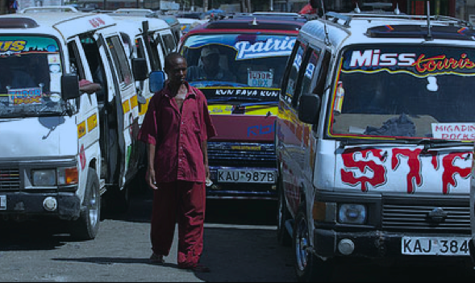
How to transform urban transport to avoid high carbon, low livability lock in?

Slide 3
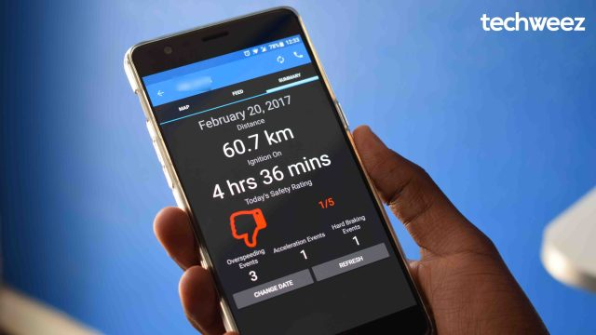
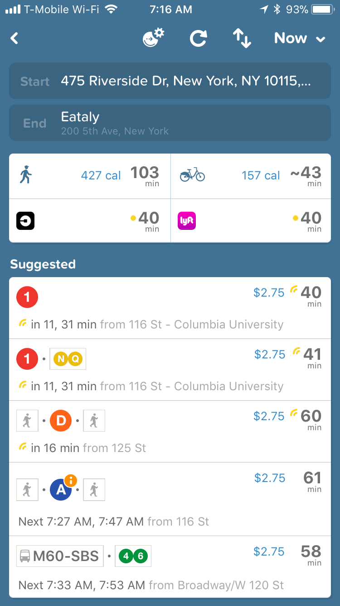
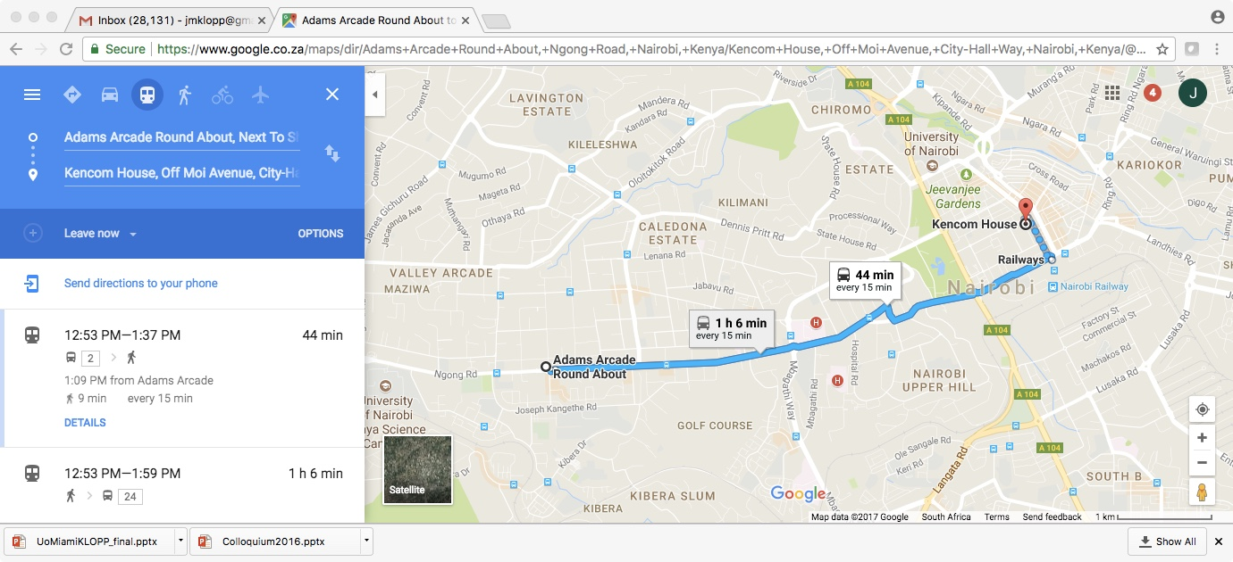
We are moving towards mobility as a service with data as the critical underlying infrastructure

Slide 4
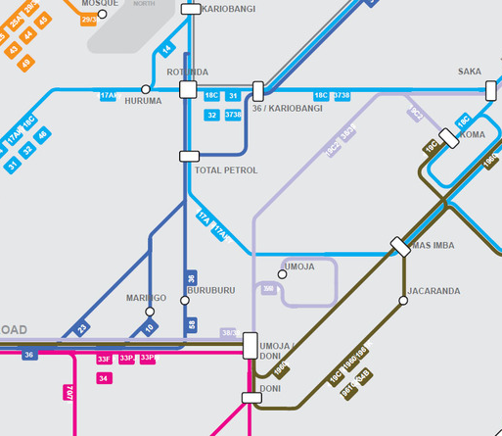
Leverage Growing Cellphone Use to Collect Missing Transit Data
DIY, COLLABORATIVE DATA COLLECTION
DEVELOP OPEN DATA=
CHANGE
+
USER/PLANNING
APPS AND INFO
TRANSPORT
MODELS
PUBLIC TRANSIT VISIBLE
INNOVATION, EMPOWERED USERS, PLANNERS
RESEARCH/ POLICY
IN (GTFS) STANDARD FORMAT
+
ONLINE AND PAPER INFORMATION FOR ADVOCACY
=

Slide 5
New Ways to See the System

Slide 6
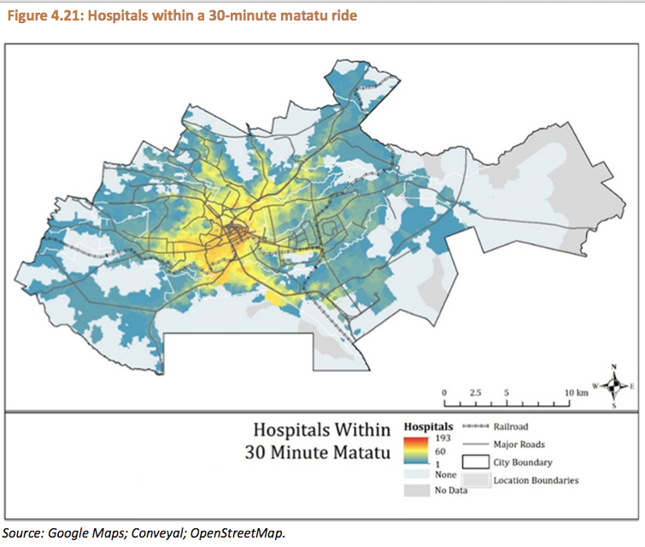
Accessibility (Avner and Lall 2016, World Bank 2016, Campbell et; al 2018)

Slide 7
Nairobi’s Matatus on Google Maps:
New Passenger Services
Accessibility is also about information.
Increases public transport use? Move towards MAS?
(Klopp et al. 2015, Shaheen et al. 2017)

Slide 8
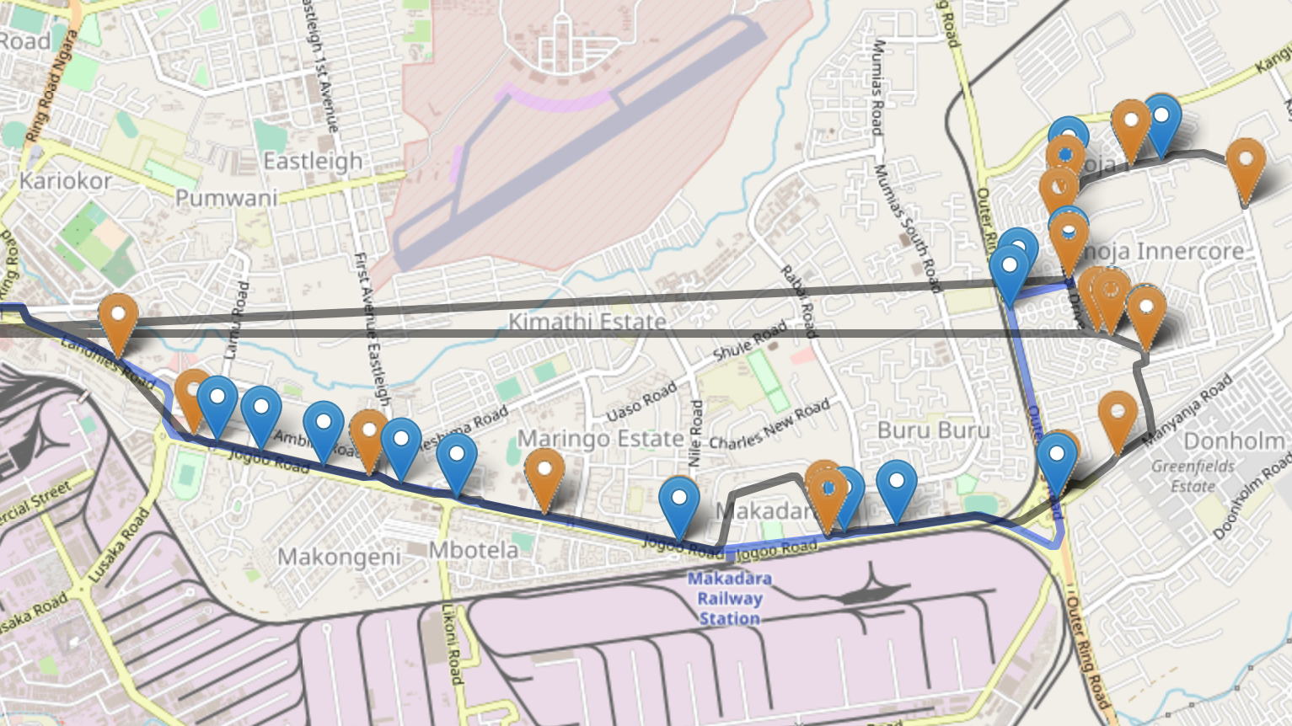
UPDATING/Maintenance?
Notes:
Institutional comment : It has a bottom-up effort. There is no institution and there is a lot of inequality coming out because there is no transport authority.

Slide 9
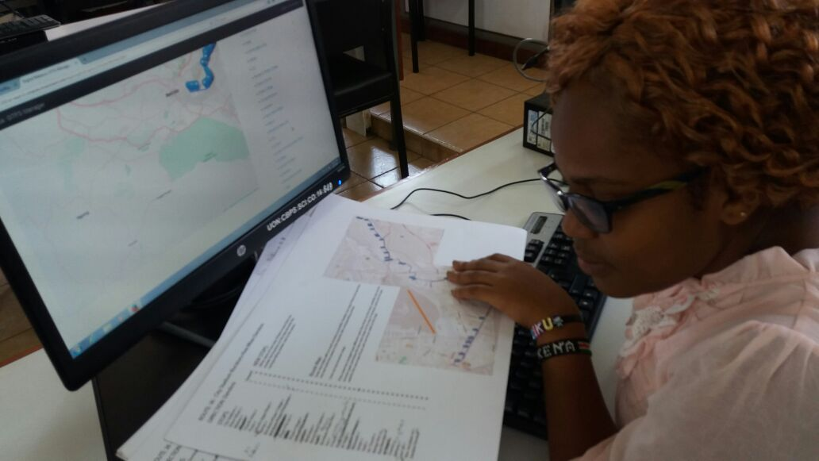
University Anchor
2. GTFS Editor during Digital Matatus 2.0
Collaborative Process, Editing Tools
Notes:
Limitations of the process- we did not ride routes, only asked drivers at main nodes in the first update. We needed a more rigorous way of verifying the data and keeping it updated.
I think you can note while showing slide 26 that the first update only involved going to main nodes and asking drivers for verification and making changes using a version of an editing tool we developed. This was not rigorous enough in terms of ground truthing and we developed a new way to more systematically and rigorously update the data! 3.0 (note we we listed as 2.0 in the program).

Slide 10
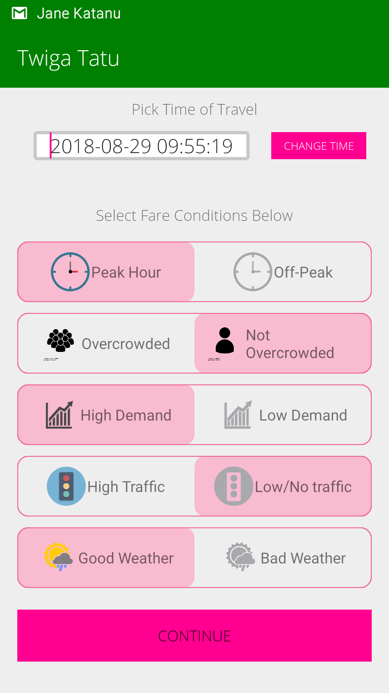
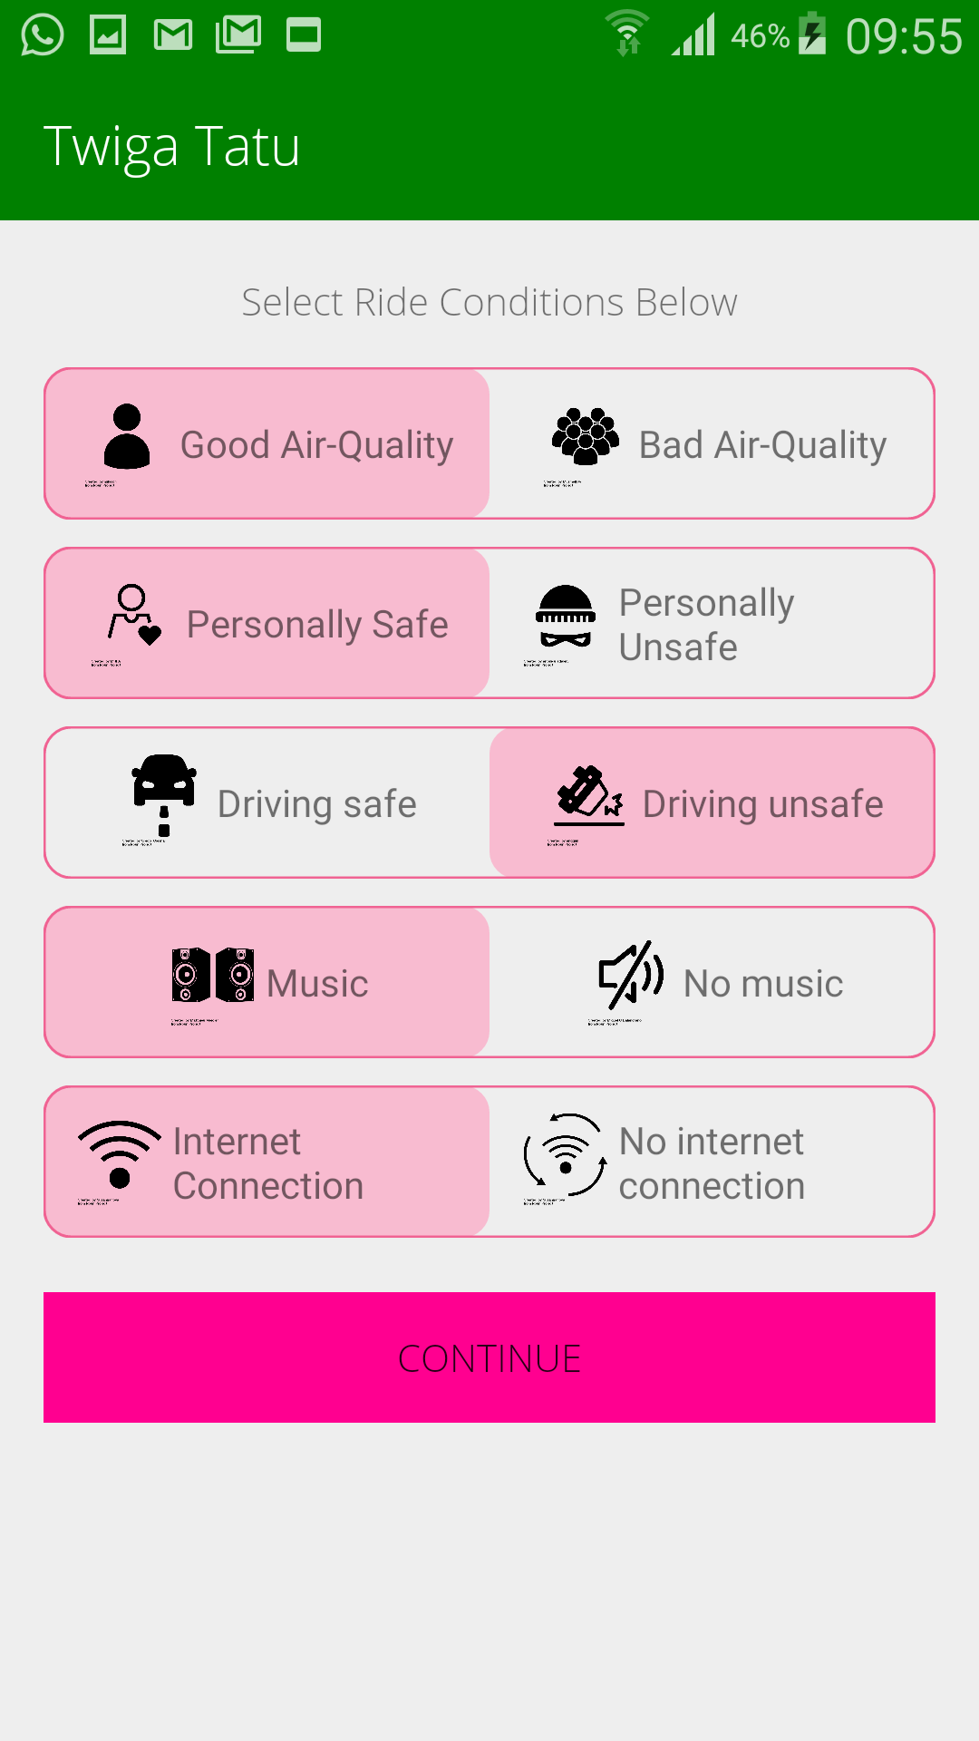
Data Improvements: Service Data

Slide 11
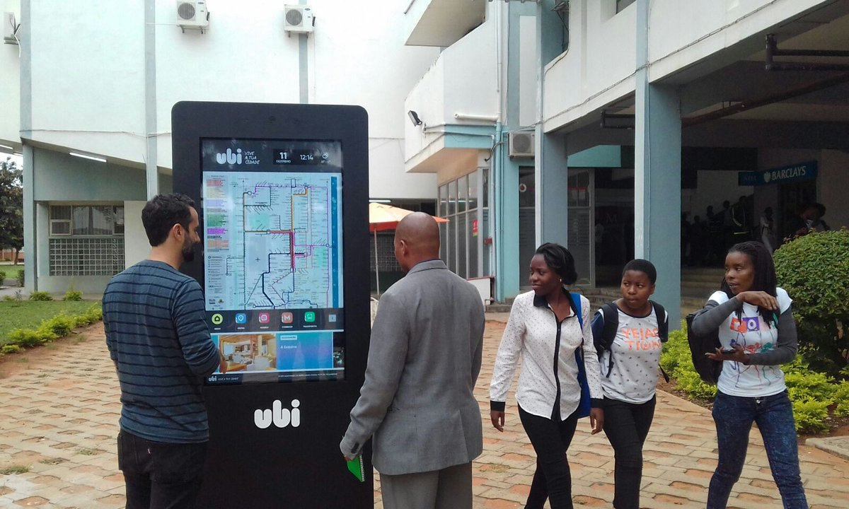
Africa can leapfrog but needs to build data & innovation eco-systems and use them to improve public transport

Slide 12
www. DigitalMatatus.com
Proud partner in DigitalCairo
Proud partner in DigitalTransport4Africa

