Slide 1
DIGITAL MAPPING OF ADDIS ABABA PUBLIC TRANSPORT NETWORK
Notes:
Good Morning Everyone, my name is Iman Abdulwassi and I am the Urban Mobility Project Coordinator for WRI Africa.
We recently established a regional office in Ethiopia and working hard to strengthen our relationship with the city. We are engaged on projects such as improving design and infrastructure of streets, neighborhoods, school zones alongside improving public transport such as BRT, LRT, public buses, shared taxis and walking, cycling. And the Digital Mapping of the Addis Ababa Public Transport Network is one of projects that is at the core of our area of work. We can only make good decisions and have good improvement ideas if we have data on the current situation. Unfortuntely, Mitiku Asmare, the Deputy of the Addis Ababa Transport Bureau could not join us today, he sends his regards. He attended the event last year here at AfD and that is where the inspiration for the project came about.

Slide 2
AGENDA
Why a Digital Map?
Mapping Project Overview
Main Findings, Challenges and Opportunities
Next Steps
Q&A

Slide 3
Why A Digital map?
Notes:
This is the map we found on one of the walls at one of the oldest Public Bus Companies called Anbessa. It may not have the spatial reference but it’s a map and it gives a good idea of the routes, the stops and key attraction points in the city. So why not keep this as it is and why did the city want a digitized map?

Slide 4
One of the Fastest Growing Cities in Africa
Addis Ababa is the largest city in Ethiopia
Population of 3.2 million people
Growing urban population
Currently 96% of the population walk and use public transport and only 4% use private vehicles
Notes:
There is a huge growing demand for public transport.

Slide 5
Why A Digital map?
Notes:
As the city grows the number of routes increase, the city size increases (you may not have enough wall space at some point) and its just very difficult to edit

Slide 6
What has the city been doing?
Restructuring transport sector and focusing on improving public transport and active mobility
Launch of Addis Ababa Road Safety Strategy
Introducing mass transit i.e. LRT, BRT
Procuring more locally assembled buses- where do we deploy these buses?
Notes:
In order to meet the growing transportation demand, the city…..now investing in public transport which it hadn’t done in the past 10 years. It also has to catch up.
Improving active mobility especially for last mile connectivity
RSS launched in 2016 with the main aim of reducing traffic fatalities through design, enforcement, data collection and communications. Shows the city is changing its approach from focusing on a car oriented city development to one that prioritizes pedestrians. So this means the city will focus its investment and time on projects that enhance accessibility and safety for pedestrians.
These are big descions and new ideas for the cit y

Slide 7
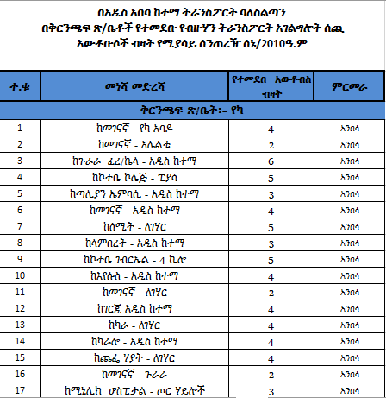
DATA! DATA! DATA!
Hard to make effective decision with little or no data i.e. demand and supply
Transport planners and operators are facing challenges when improving or integrating different modes of transport i.e. BRT and paratransit
Currently data is collected manually which makes it difficult to update the data collected, visualize all the data in one platform and represent spatial information
Notes:
The city cannot achieve its goal to meet transportation demand if it doesn’t know where the demand it, what time the highest demands are, what time the lowest demands are and why, travel patterns, how are the different modes integrated, whose feeding into what or is there a lot of overlap
Addis has an advatange because it has some initial data

Slide 8
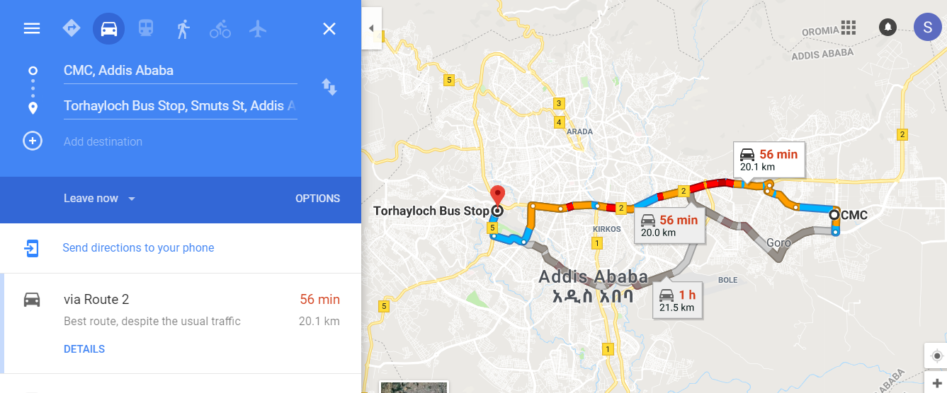
Trip Planning

Slide 9
Main Reasons for Digital Public Transport Data
Wealth of data that already exists but not in the “right” format
Better understand paratransit patterns
Route planning/allocation & Service Improvement
Way to come together for decision making

Slide 10
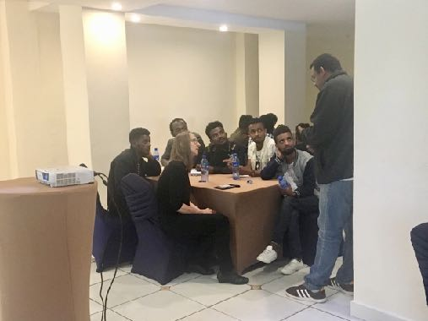
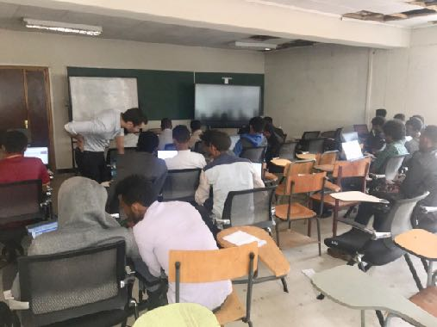
TRANSPORT AUTHORITY TOOK ACTION
Nov,2017 Paris
Dec, 2017 Addis Ababa
Jan – April, 2018
April – June, 2018
July- September, 2018
Digital Transport for Africa Conference
Discussion with Digital Matatus, TfC and WRI
Workshop on leveraging digital technologies for transport data
Developing Work Plan
Finding local partners
Agreements with Addis Ababa Universities
Training on Digital Mapping
Data Collection
Post Processing
Quality Assurance
Notes:
Good relationship with the city
Work plan took the longest time – no one way to do it, every city has its own opportunities and challenges
First time it was being done

Slide 11
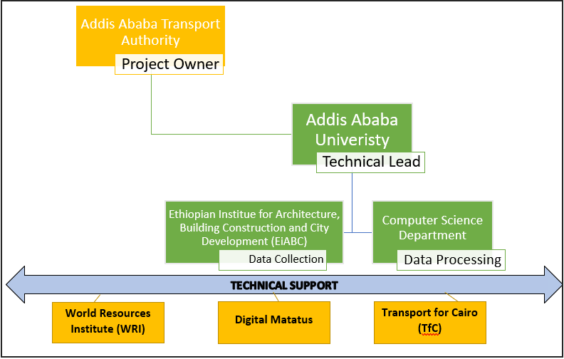
STAKEHOLDERS
Notes:
UNIQUE
Experience sharing from other African cities – relatable

Slide 12
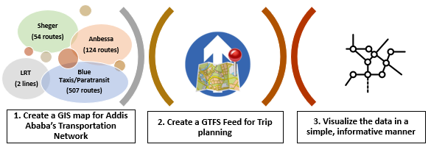
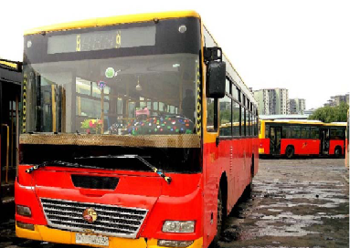
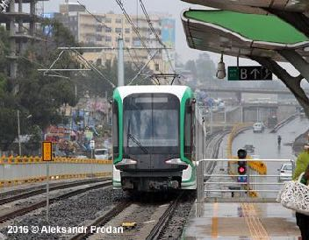
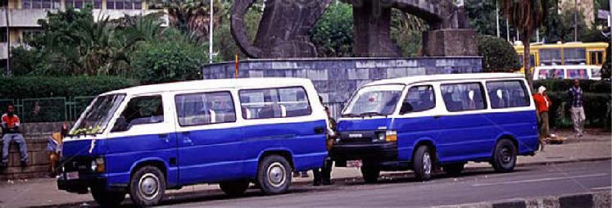
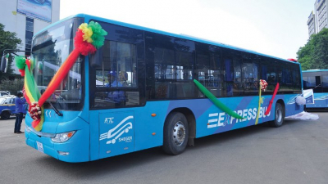
OBJECTIVES

Slide 13
PROCESS
Route Assignment
Assignment of routes to each student
Unique ID number
Data Gathering
Smart phones
Data gathering apps
Routes & Stops
Data Management
Where is it stored?
Clean data/Discarded routes
Post Processing
GIS format
GTFS Feed
Quality Assurance
At each stage especially during data gathering
Need to do it multiple times

Slide 14
PROCESS….cntd
Organize Assignment Sheets
Origin - Mid - Destination
Assign data collectores
Assign a unique ID
Invalid Raw Trip
Capture Trip (Instance)
Record GPS Trace
Record Stops
Import data from phones
Organize Raw Data
Invalid processed Trip
Assign subsets to editors
Extract subsets for processing
Quality Assurance
Process Data
Geometry
Attributes
GTFS Standards
Terminals Digitization
Trips Digitization
Stops Digitization
OSM editing
Notes:
Our approach to gathering and storing data is a GIS-first approach. Meaning we store and organize our data in a Geographic information system, from which we convert this data into GTFS feeds.

Slide 15
1.DATA LAYERS – ROUTES

Slide 16
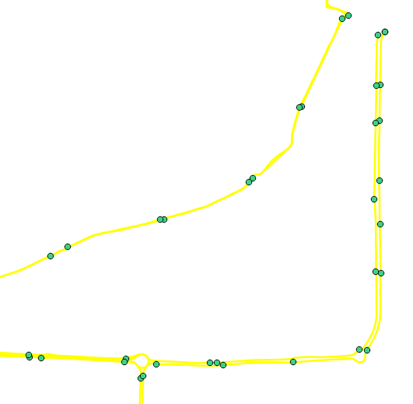
2. DATA LAYERS: STOPS
Stops
Single Instance per Trip
Multiple Instances per Trip
Notes:
How to create stops

Slide 17
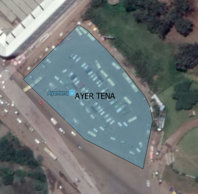
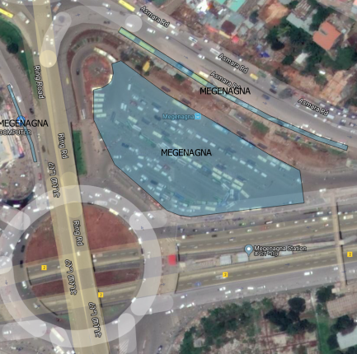
3. DATA LAYERS: TERMINALS

Slide 18
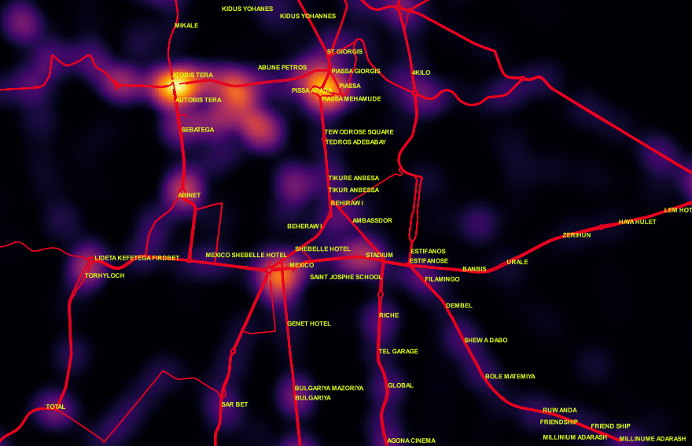
Already we can where the demand/cluster points are

Slide 19
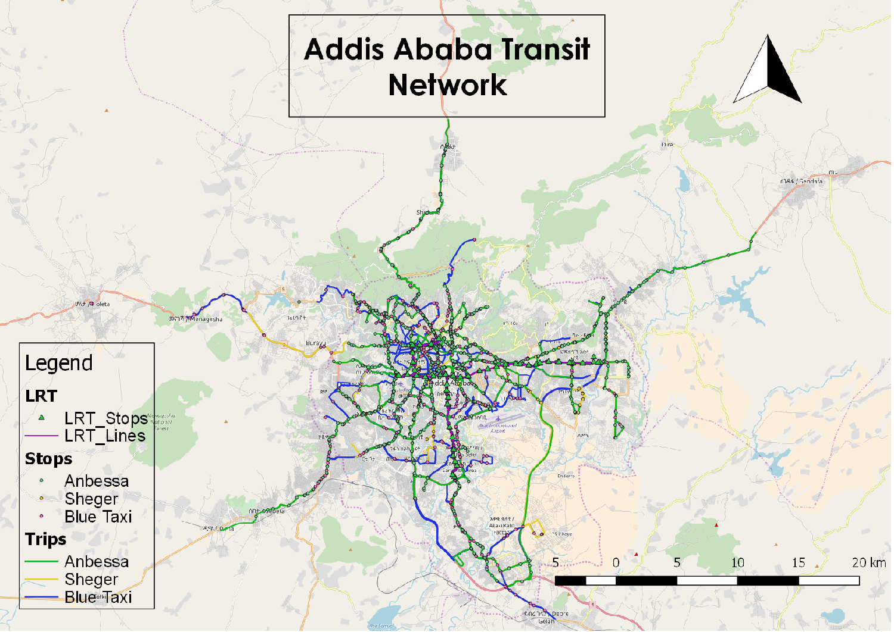

Slide 20
Challenges
Data Collectors
Data Processors
Technical Partners
Phone models varied and some did not support data collection apps with newer systems/versions
Inaccurate and overlapping baseline data
Unavailability of buses and taxis
Taxis take different routes than the assigned ones
Transportation cost higher than legal tarrifs
Technical difficulties with data collection app
GPS problems due to cloudy weather
Limited and interrupted internet access
Electric power interruption
Errors and lack of street connectivity on Open Street Map
Inaccurate and overlapping baseline data
Difficult to get data from data collectors daily as manually uploaded
Data not saved in correct coding format
Errors on manually recorded data on daily assignment sheets
Differentiate what we mean by maps and mapping (GIS, GTFS)
Inaccurate and overlapping baseline data delayed project and difficult to manage project/assign tasks
Simultaneously building capcity and working with students on data gathering and processing
Time constraint
Budget constraint

Slide 21
Main Findings
Easier to map shared taxis than Anbessa and Sheger
Having initial datasets/spreadsheets are a helpful starting point
Certain apps are not best fit for cities with similar local conditions as Addis i.e. internet connectivity is expensive and not easily accessible
Need to map multiple times to pinpoint the stops accurately
Taxis take routes high in demand and take shortcuts
Taxis don’t always adhere to tariffs
Lack of awareness of open tool i.e. QGIS/ My maps
Already existing local capacity that just needs additional training in some areas that can be tailored to the project needs
Sustainability is an important component of these kind of projects
Having the government support was crucial in getting the project done on time

Slide 22
Opportunities
Support with transport planning i.e. BRT, TOD, Cycling
Enable street network data for decision makers and researchers
Contribute to open source data especially African cities
Opportunities Identifying patterns for different modes of transport
Generate Innovation i.e. crowd sourcing app, government and university
Trip Planning
Analysis i.e. Heat Maps, accessibility
Notes:
AATA can convene all stakeholders such as Sheger, Anbessa, Taxi association and transport planners to discuss how to optimize transportation routes, identify supply and demand, BRT integration and more, last mile connectivity with walking and cycling

Slide 23
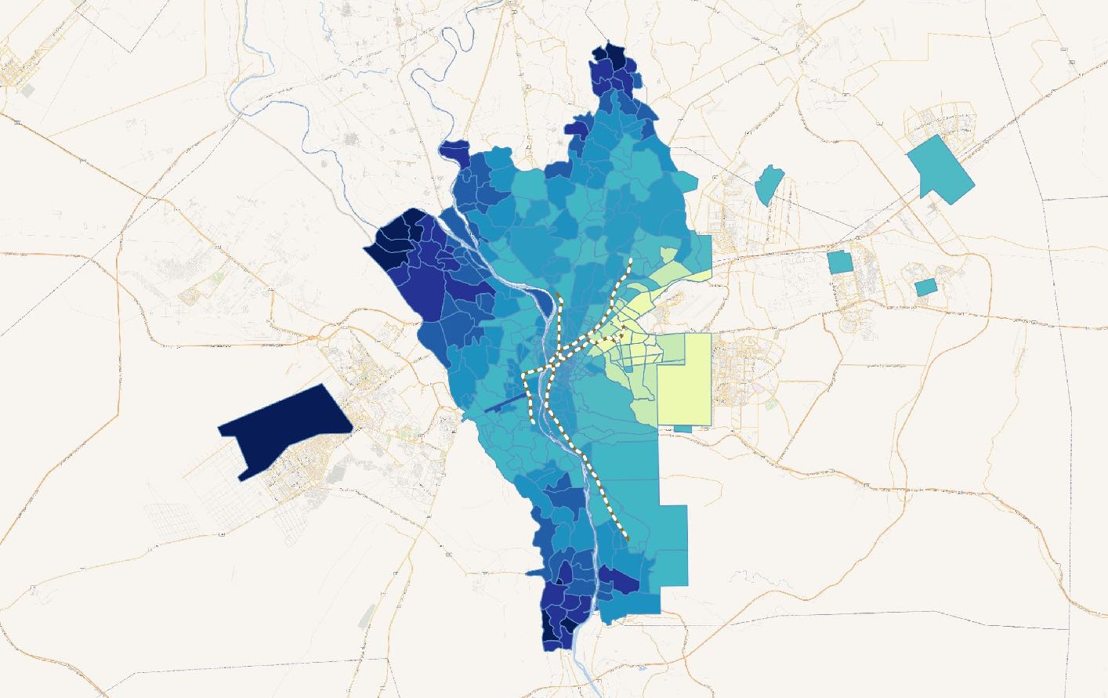
HEAT MAP EXAMPLE
Driving time Heat-map
The map shows the average travel time from the origin zone (Cairo Airport) to all other zones for a given date-time range. (21-06-2017 at 8:30 am)
'CC-BY-NC' Transport for Cairo (TfC) L.L.P., 2017. Basemap © Wikimania

Slide 24
ATTRIBUTES
Attributes
Better Customer Experience
Affordability
Sustainability
Availability
Safety
Accessibility
Acceptability
Data & Tools for Industry and Decision-makers
System Adequacy
Map/
Data
Temporal
Geography

Slide 25
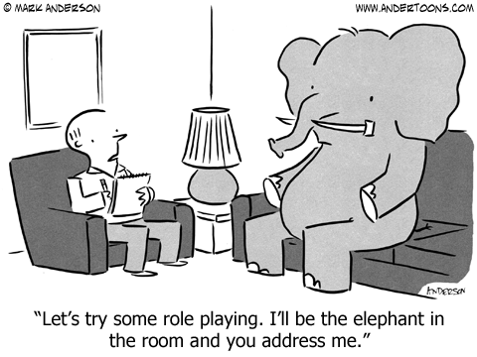
Elephants in the room
Paratransit regulate or not?
BRT vs. Paratransit
Meaning of informality
Public good/ Public data Ownership

Slide 26
NEXT STEPS
Finalize GIS map and GTFS database
Organize a workshop on schematic mapping/ visualization
Hand over project to the city
Capacity building for transport authority team on data collection, processing, maintaining, updating of data
Support the city technically until city is comfortable with the process
Temporal data and Adequacy parameters

