Slide 1
DATA COLLECTION FOR PLANNING AND MANAGEMENT
DEPARTMENT OF TRANSPORT

Slide 2
INTRODUCTION
Transport planning and management is a major duty of the Assembly (Act 462 etc)
Transport services are carried out by Unions and Associations
There are about 113 terminals/loading points within the city with Kejetia being the biggest which is currently undergoing reconstruction

Slide 3
PROBLEM STATEMENT
Inadequate terminals spaces (hence the use of streets and lay byes for transport activities)
Operators starting transport services without recourse to the Assembly
Inadequate information on terminals/loading points:
Location and Size
Unions / Routes and Vehicles used

Slide 4
Reduction in the number of permit issuance yearly
Inadequate enforcement services

Slide 5
PROPOSED SOLUTION
Transport Information Mapping (TRANSINFOMAP) is a collection of software tools for;
Data capturing (Information on terminals, unions and routes and all commercial vehicles)
Mapping
Revenue Management
Reporting and Analysis

Slide 6
PHASE 1
ACTIVITIES
Sensitization was fairly carried out in all the sub-metros
Vehicle and Driver questionnaire was given out to be filled and submitted to the Department
Terminal and loading point information (size, GPS coordinates, etc) was collected from the sub-metros
Some data was captured
TECH PRINT.docx

Slide 7
PHASE 2:
Develop data collection strategies due to some of the challenges encountered in phase 1
Develop Software applications to assist in;
Digital data capturing
Mapping capabilities
Reporting and Analysis
Engage data collection teams to assist in data capturing including but not limited to;
Terminal information, Vehicle information, Driver information

Slide 8
DIGITAL MAP
PHASE 3

Slide 9
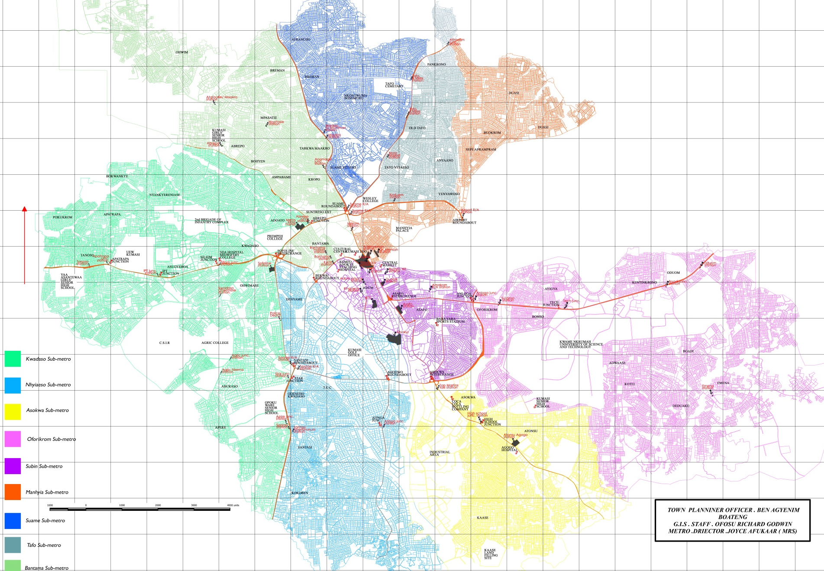
KUMASI SUB-METRO MAP

Slide 10
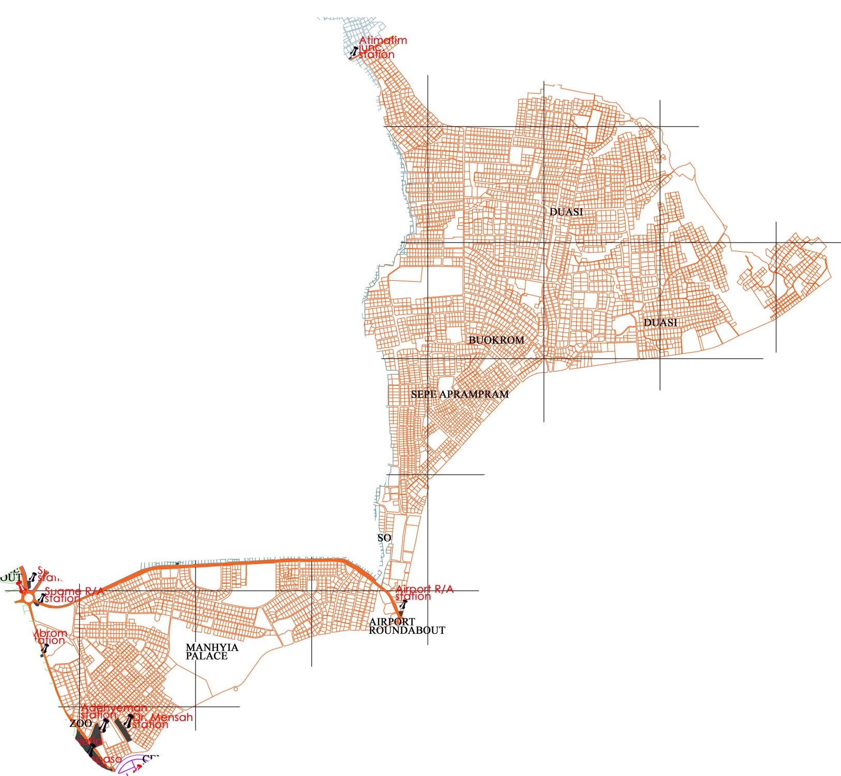
MANHYIA SUB-METRO MAP

Slide 11
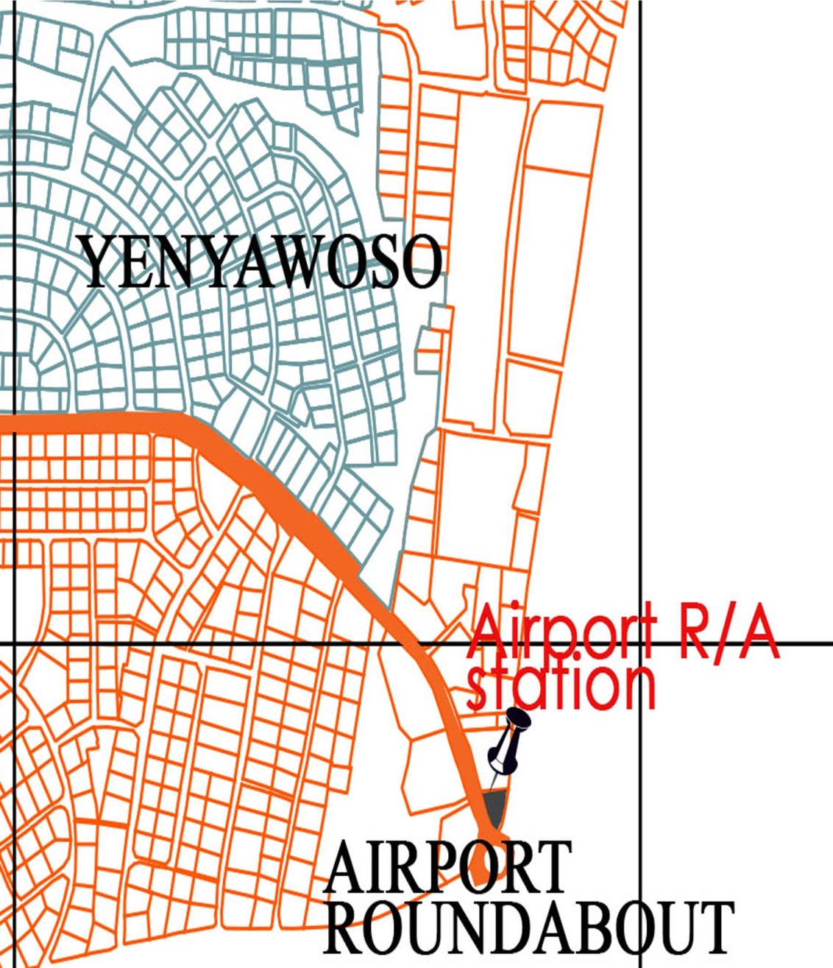
AIRPORT ROUNDABOUT STATION

Slide 12
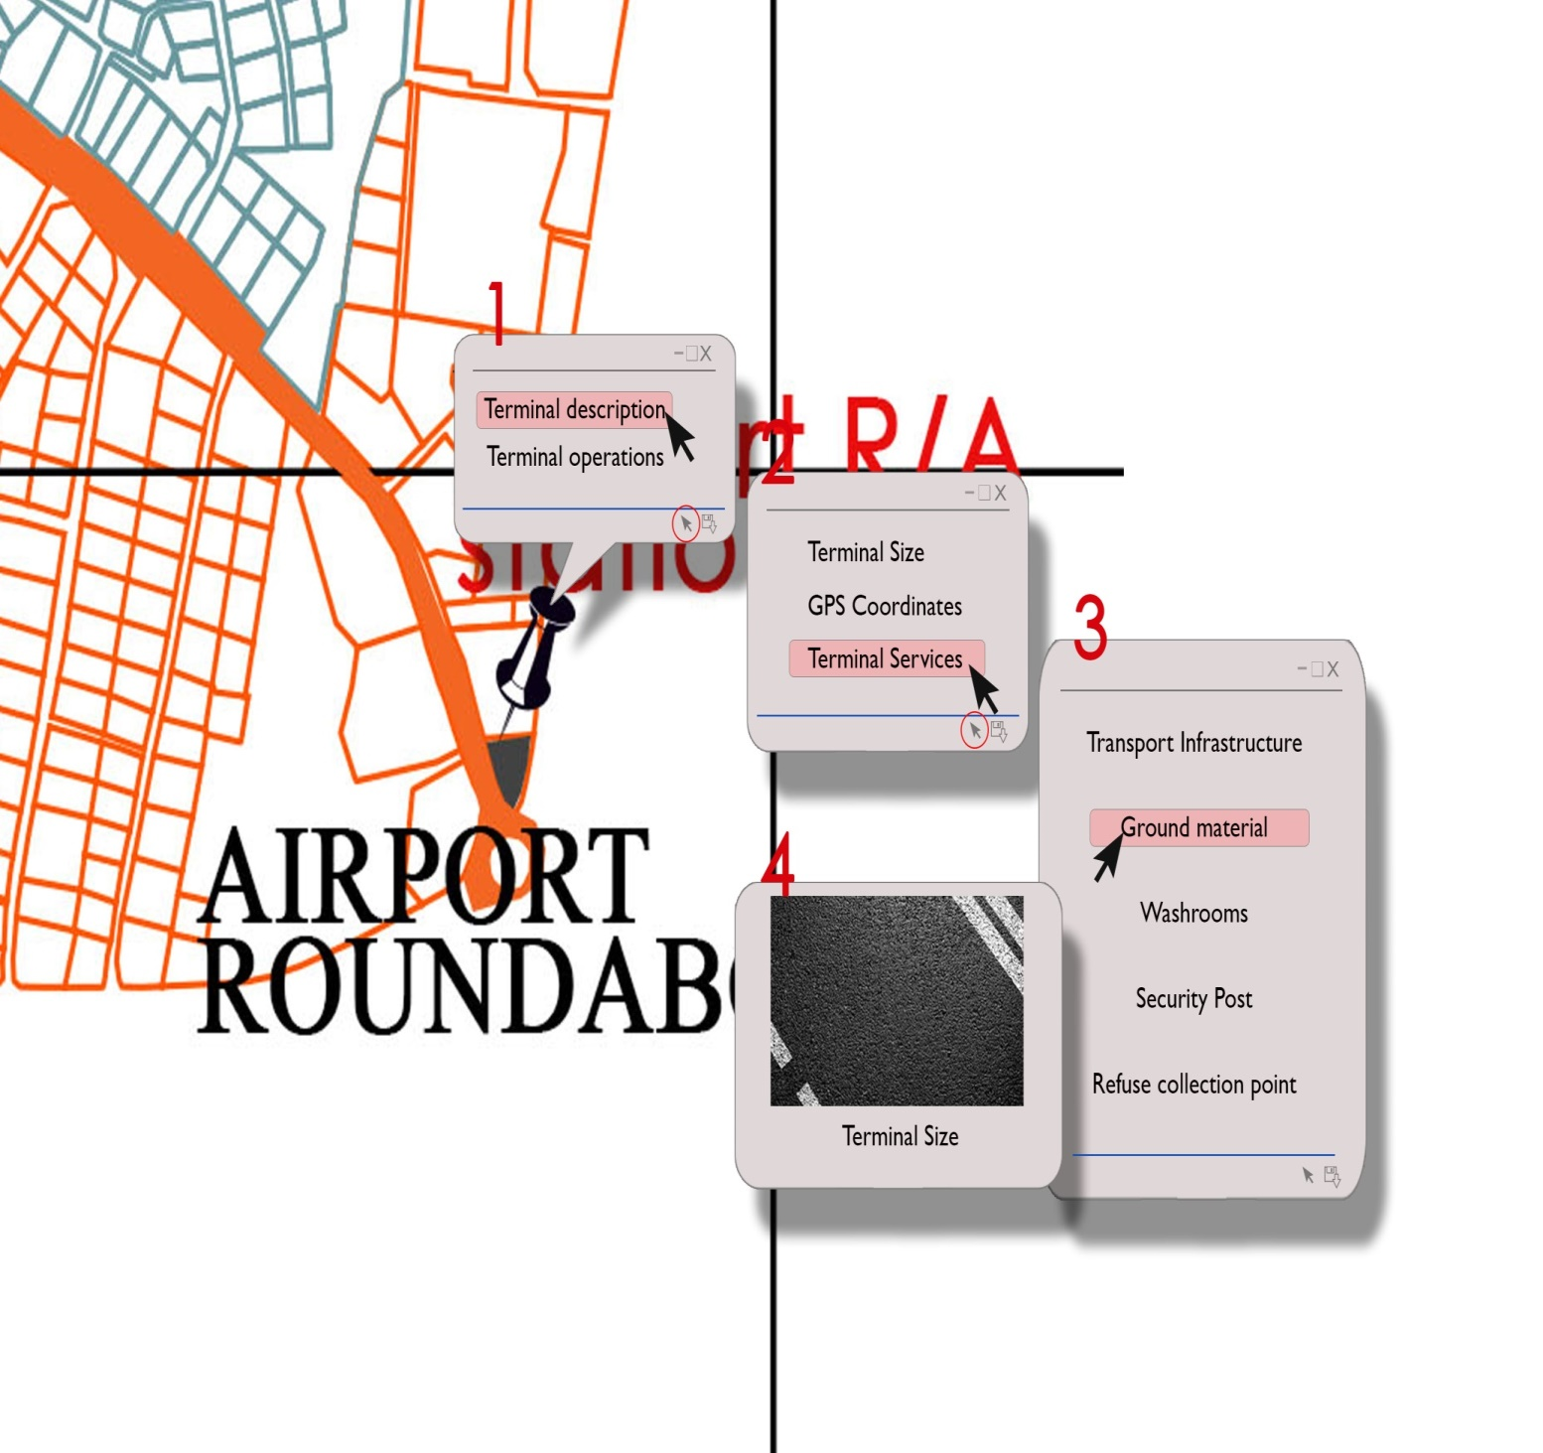
AIRPORT ROUNDABOUT STATION

Slide 13
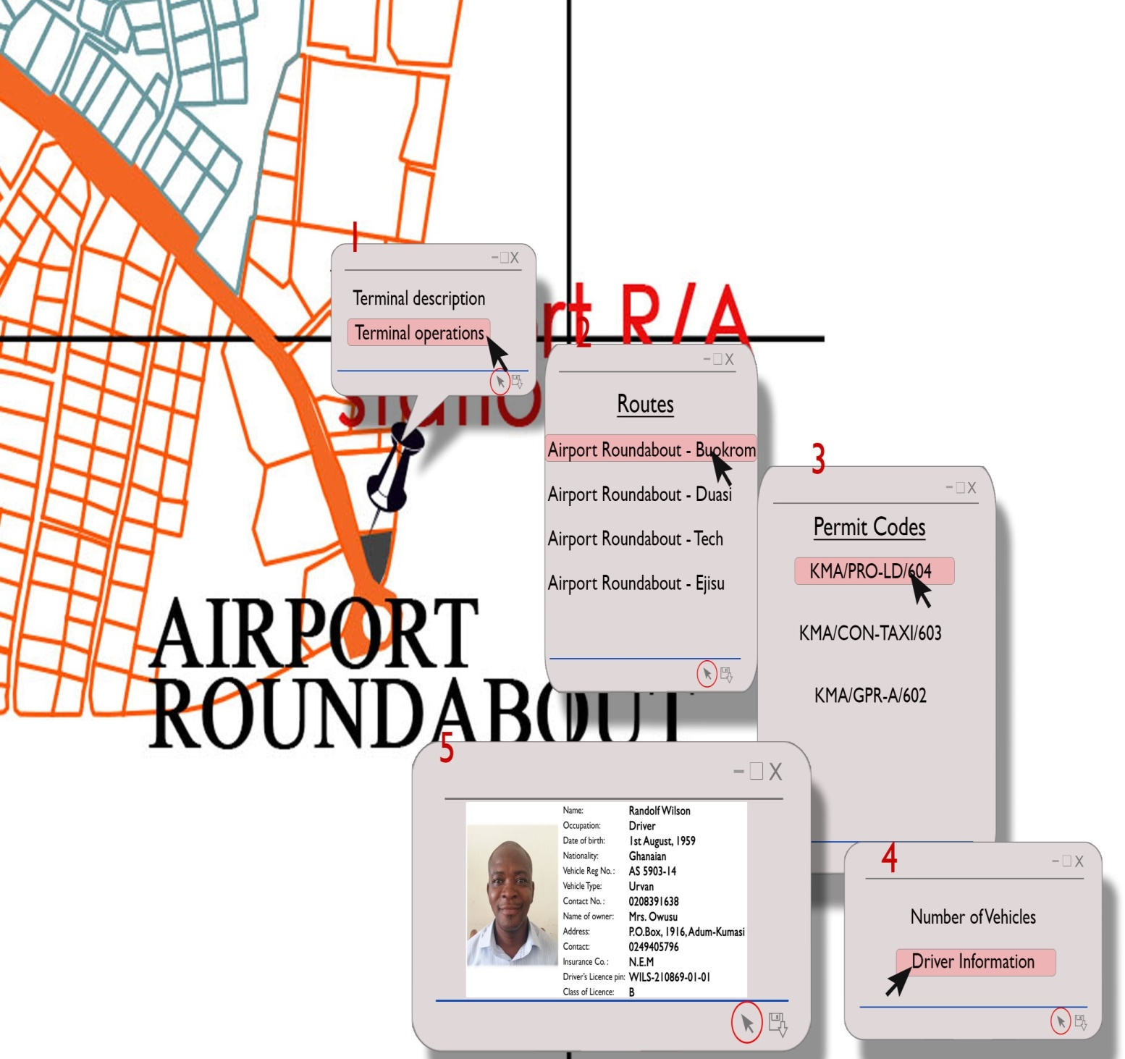
AIRPORT ROUNDABOUT STATION

Slide 14
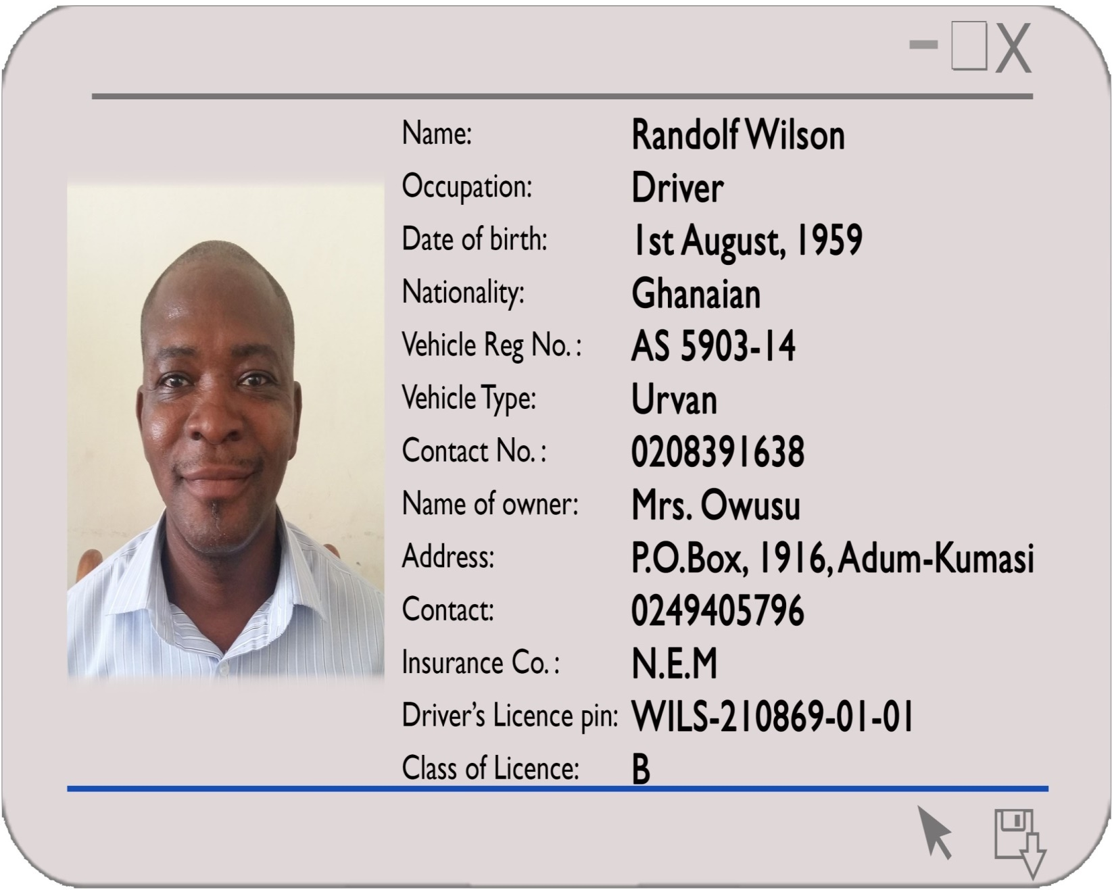
DRIVER’S INFORMATION

Slide 15
BENEFITS OF THE PROPOSED SOLUTION
Traffic Control
Vehicle terminal allocation,
Easy route planning
Vehicle Information Management
Ability to identify specific vehicles and their routes using our new “route stickers”
Reduce the number of floating vehicles within the Kumasi Metropolis
AHODWO.docx

Slide 16
BENEFITS
Total Revenue Control (revenue mobilisation collection and management)
Ability to track active commercial vehicles for billing and revenue collection (Daily and yearly Tools)
Track payment of route stickers
An organized database for the Transport Department in the Kumasi Metropolis
Monthly Rev Kwame 2018.xlsx
G.P.R.T.U.xlsx

Slide 17
For the Intended Bus Service
Establish appropriate stakeholder engagement and involvement for integration of operators
Create a database of trotro operations
Reveal demand for the services and number of buses to serve the demand
Highlight the appropriate fare charges along the various corridors

Slide 18
Develop a business case for the bus operations
Define infrastructure requirement needed to start operations
Identify required capital and sources of funding
Establish the need for institutions

Slide 19
CONCLUSION
A well labelled map of Kumasi, which has all the transport terminals located on and linked to data for on each terminal or loading point which will assist in planning
The Trotro route map will help create a feeder link for the Mass Transit corridors
This information will help all stakeholders (KMA/Sub-metro, Transport Unions, Drivers, General public) to have peculiar information which can be used to take decisions.

Slide 20
THANK YOU

